Slide 1
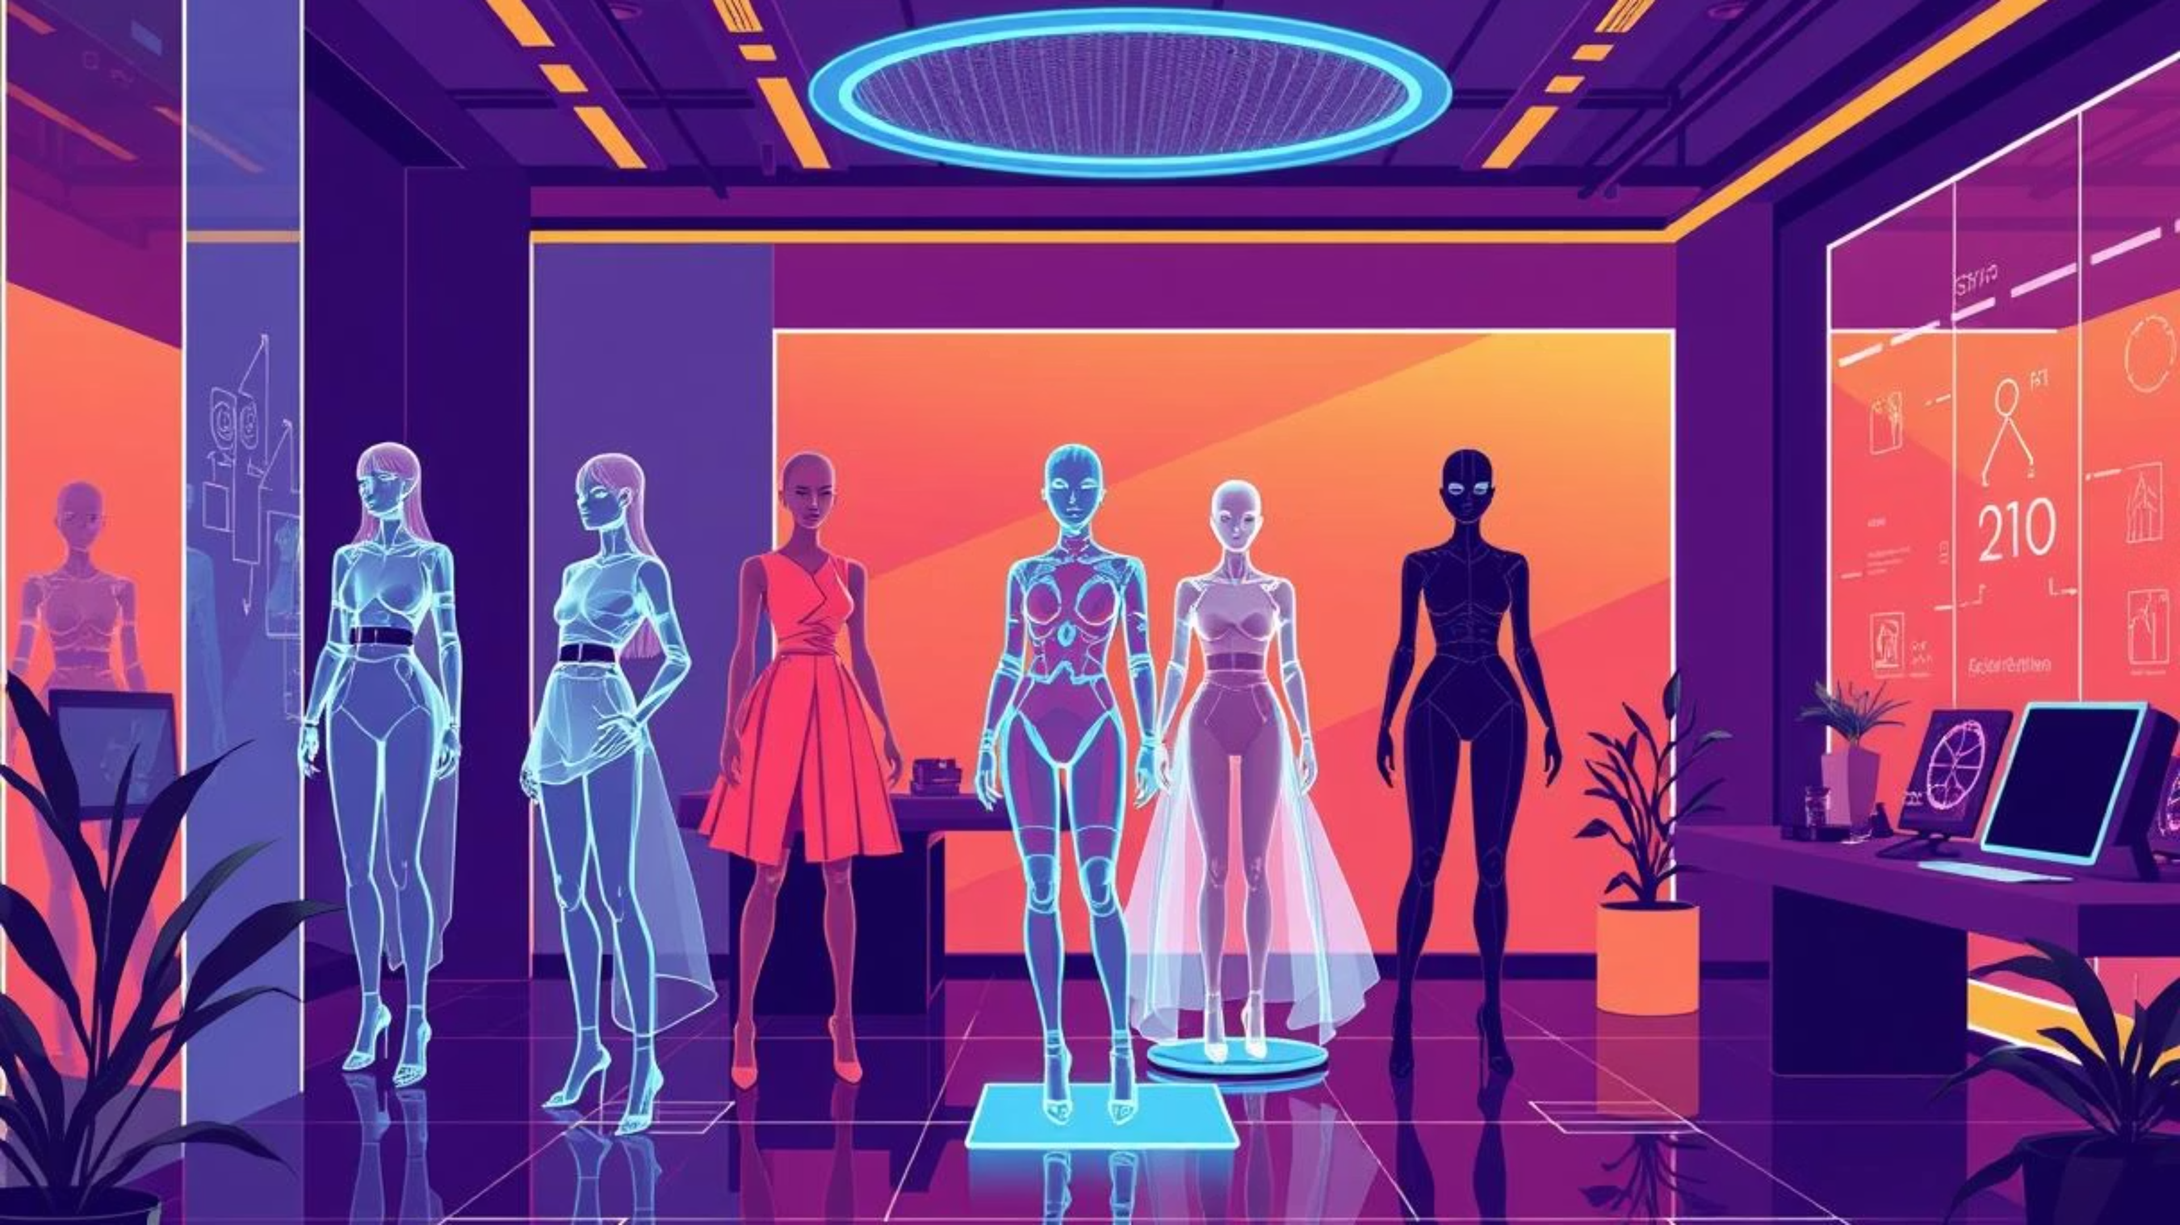


StyleSync: AI Driven Personalized
Fashion Hub
Presented by
Name: Aayush Bhavesh Pandya
Enrollment No: 23002171310001
Roll No: 30
Branch: CST
Division: D1

Slide 2




Project Overview
StyleSync revolutionizes the way users interact with fashion, offering a personalized and engaging experience tailored to individual needs. We aim to simplify style discovery and elevate your wardrobe with cutting-edge technology.
AI-Powered Personal Stylist
Seamless E-commerce Integration
Local Fashion Discovery
Our core feature leverages advanced AI to provide personalized outfit recommendations based on your preferences, mood, and occasion. Say goodbye to fashion dilemmas!
Discover and purchase recommended fashion items directly through our integrated e-commerce platform. Your perfect look is just a click away.
Stay updated with local fashion events, pop-ups, and exclusive collections through our "Fashion Fest" feature, connecting you with the vibrant local style scene.

Slide 3





Under the Hood: Technology Stack
Frontend
Backend
Database
React, Vite, Axios, and Lucide-React create the interactive and responsive user interface for a smooth style discovery experience.
Node.js, Express.js, Django, and Django REST Framework handle server-side logic, API development, and data processing for seamless communication.
MongoDB with Mongoose stores all user profiles, fashion item catalogs, and preference data, ensuring efficient data modeling.
AI & Machine Learning
Authentication
FashionCLIP, InsightFace, OpenCV, and PyTorch power advanced image analysis, facial recognition, and personalized fashion recommendations. Fine-tuned the FashionClip model using dataset from kaggle of 44,000 images from fashion product images by paramaggarwal
JSON Web Tokens (JWT) ensure secure user authentication and robust password using password regex methods, safeguarding user data and access.

Slide 4





Key Features of StyleSync
AI Stylist
E-commerce Shop
Fashion Fest
Upload an image of yourself or a clothing item to receive highly personalized outfit recommendations tailored to your style, mood, and occasion. Our AI analyzes your inputs to suggest the perfect look.
Seamlessly browse and purchase fashion items from a curated selection, including AI-recommended pieces and a wide range of admin-added clothing. Find everything you need to complete your wardrobe, all in one place.
Discover, share, and engage with local fashion events, pop-ups, and exclusive collections. Upvote your favorite events, read reviews, and connect with the vibrant local style community.
Secure Authentication
Admin Dashboard
Robust and secure login and registration processes for both users and administrators. We utilize JSON Web Tokens (JWT) and bcryptjs to ensure your data and privacy are protected at all times.
A comprehensive dashboard for administrators to efficiently manage products, oversee fashion events, review user complaints, and maintain the overall platform with ease.

Slide 5




Conclusion:
StyleSync successfully demonstrates the power of AI in creating a personalized and interactive fashion platform. It offers a robust foundation for revolutionizing the online fashion experience.
Future Vision: Expanding StyleSync
Virtual Try-On with AR
Accessory Recommendation
Integrate an augmented reality feature for users to virtually try on clothing items before making a purchase, enhancing the online shopping experience.
Expand the recommendation engine to include various accessories like jewelry, bags, and shoes, providing complete outfit suggestions.
Dedicated Mobile App
Social Sharing & Community
Develop a native mobile application for both iOS and Android to offer a more seamless and integrated user experience on the go.
Introduce a social component, allowing users to share their styled outfits, receive feedback, and engage with a vibrant fashion community.

Slide 6
Thank You

